Slide 1

Entertainer Data Analysis
Python | Power BI
By Divakar K G | Data Aspirant

Slide 2
Problem statement
Problem Statement
Normal life can be stressful, and people need to relax. Being entertained by others is a wonderful way to take some time out of life. It can reduce stress and make life’s issues easier to face. The media and entertainment industry consists of film, television, radio and print. These segments include movies, TV shows, radio shows, news, music, newspapers, magazines, and books. Entertainment industry is a group of sub-industries devoted to entertainment. Entertainment industry is used to describe the mass media companies that control the distribution and manufacture of mass media entertainment.
By Divakar K G | Data Aspirant

Slide 3
Tasks Given
Task #1 - In a word document write the process and data added to the current dataset.
In addition, mention the theme on which you will be creating the dashboard.
Task #2 - You can add your data as per your convenience.
Task #3 – Do the data preparation part.
Task #4 – Build the dashboards
Task #5 – Build a Storyline
By Divakar K G | Data Aspirant

Slide 4
Project Details
Title | Entertainer Data Analysis
Technologies | Business Intelligence
Domain | Film and Entertainment
Project Difficulties level | Intermediate
Programming language used | Python, SQL
Others tools | PowerBi, Excel, Jupyter Notebook
By Divakar K G | Data Aspirant

Slide 5
Objective
This project will create a Power BI Dashboard to look at entertainers' careers and their movies over time. It will show how many movies they've made, their genres, box office results, and reviews. Users can see trends, important moments, and compare different entertainers. It will also highlight key movies and industry trends based on acheivements year. The goal is to help understand the film industry better.
By Divakar K G | Data Aspirant

Slide 6






Flow Chart
+
Provided Dataset
Populated Dataset
Interactive Dashboard
As the provided data is not sufficient for data analysis, To populated data for the given entertainers and
stored Kaggle IMDB Dataset & pandas library.
By Divakar K G | Data Aspirant

Slide 7
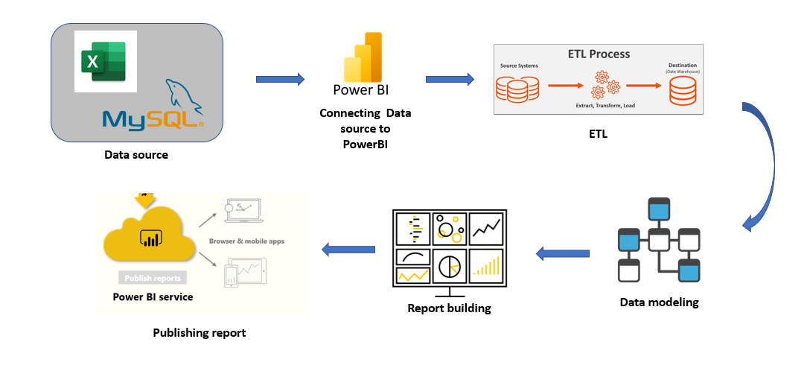
Power BI Architecture
Overall architecture of the project, which was used to build the dashboard
By Divakar K G | Data Aspirant

Slide 8
Dataset Information
Given Dataset:
Entertainer-Basic Info: It consists of list of 70 Entertainers Name, Birth year and Gender
Entertainer-Breakthrough Info: It consists of details about the 70 entertainers like breakthrough year, first major award, breakthrough movie name
Entertainer-Last major work Info: It consists of the details about the 70 entertainers last major work and if died, Year of death details.
By Divakar K G | Data Aspirant

Slide 9
Populated Dataset
Entertainer: Name of the entertainer.
Gender (traditional): Traditional gender of the entertainer.
Birth Year: Year the entertainer was born.
Year of Breakthrough/#1 Hit/Award Nomination: Year the entertainer had their first big hit or major nomination.
Breakthrough Name: Name of the breakthrough project.
Director: Director of the breakthrough project.
Breakthrough Image: Cover image of the breakthrough project.
Year of First Oscar/Grammy/Emmy: Year the entertainer won their first major award.
Headshot: Headshot of the entertainer.
Height: Height of the entertainer.
Number of Films Acted In: Total number of films the entertainer has acted in.
By Divakar K G | Data Aspirant

Slide 10
Populated Dataset
Quote: Famous quote by the entertainer.
Award Won from Breakthrough: Award won from the breakthrough project.
Total Awards Won: Total number of awards won.
Total Nominations: Total number of award nominations.
Profession: Entertainer's profession (e.g., actor, singer).
Oscar Won: Number of Oscars won.
Grammy Won: Number of Grammys won.
Emmy Won: Number of Emmys won.
Other Awards Won: Number of other awards won.
Average Rating: Average rating of the entertainer's films.
By Divakar K G | Data Aspirant

Slide 11
Some of the insights from the Report
Entertainer’s Overview Page
Adele: The page highlights key information about Adele, including her height (5'9"), birth year (1988), and the number of films she has acted in (14).
Career Milestones: Adele’s breakthrough year is noted as 2008, with her first award coming in 2009.
Awards: She has won 1 Oscar, 15 Grammys, 0 Emmys, and 16 other awards, totaling 32 awards.
Performance Rating: Her performance rating is 7.00.
Famous Quotes: The page also features a quote attributed to Adele, adding a personal touch to her profile.
Movies Overview Page
Breakthrough Films: The table lists various breakthrough films along with their breakthrough year and whether they won an Oscar.
Visual Appeal: Each film entry includes a cover image, adding to the visual attractiveness of the page.
Top Movies: The page highlights the top movies, showing a bar chart of movie ratings by breakthrough name.
Details: It provides specific details like the name of the director and awards won, enhancing the informational value.
By Divakar K G | Data Aspirant

Slide 12
Cont...
Overall Performance & Evaluation Metrics
Clustered Chart: Displays the number of Emmy, Grammy, Oscar, and other awards won by entertainers.
Top Entertainers by Awards: The clustered chart shows Oprah Winfrey and Meryl Streep as top Emmy and other award winners, respectively.
Gender Distribution: A donut chart indicates that 71.43% of the dataset consists of males and 28.57% are females.
Profession Distribution: Another donut chart shows that 68.57% are actors and 31.43% are singers.
Insights
Award Distribution: Oprah Winfrey leads in Emmy wins, while Meryl Streep dominates other awards.
Diversity: The dataset includes a significant number of actors compared to singers, with a male predominance.
Top Films: Films like "East of Eden" and "The Fame" have the highest movie ratings in the dataset.
By Divakar K G | Data Aspirant

Slide 13
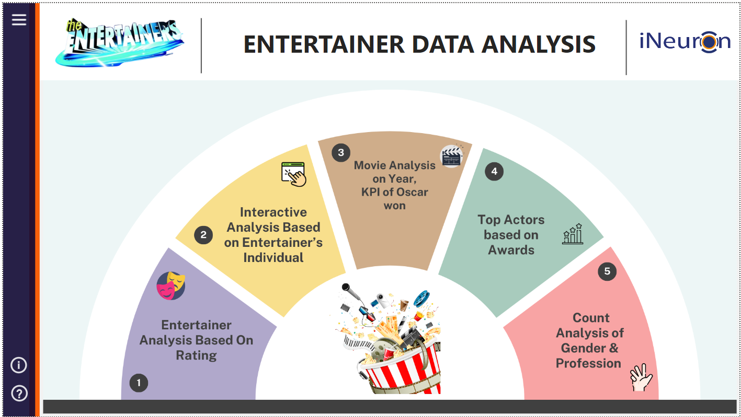
Home Page
By Divakar K G | Data Aspirant

Slide 14
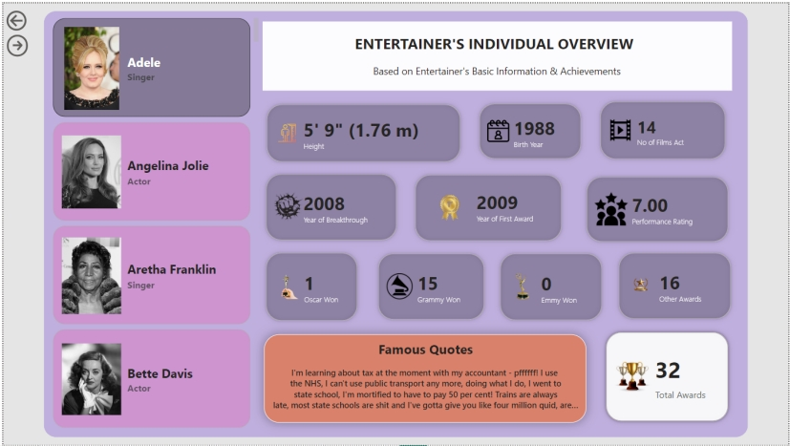
Entertainer’s Overview Page
By Divakar K G | Data Aspirant

Slide 15
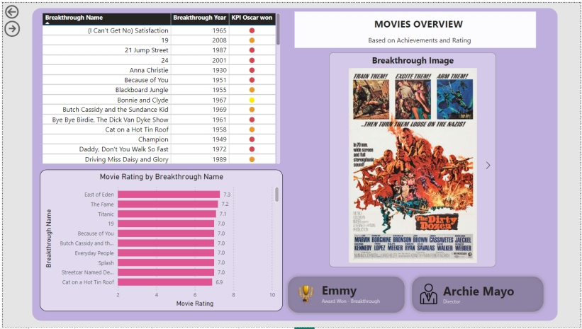
Movie Overview Page
By Divakar K G | Data Aspirant

Slide 16
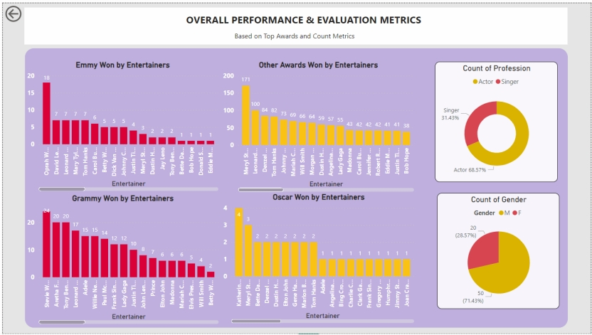
Overall Performance & Metrics Page
By Divakar K G | Data Aspirant

Slide 17
Dedicated Thanks
to
iNeuron Team
By Divakar K G | Data Aspirant

